Slide 1
1

Slide 2
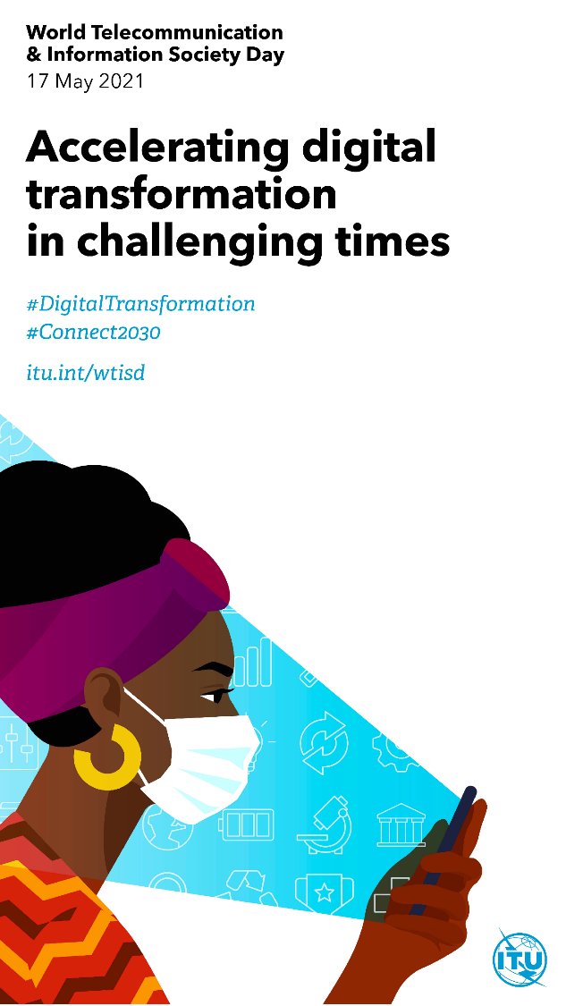
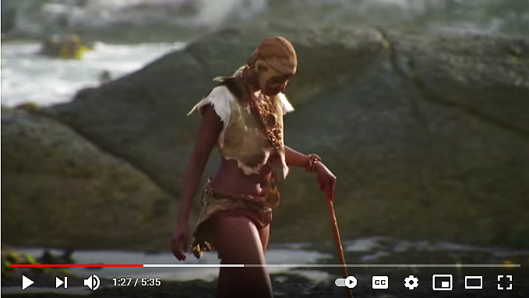
South Africa | Cradle of Humankind
Birth of Homo erectus: place & date of birth: Makapansgat, South Africa, 3 million years ago
Home of Homo sapiens | Took a Long Walkabout to populate the whole world
Now facing challenging times – ICT4ALL urgently needed
2
Time Machine
The
origins of innovation
>100,000 years ago
Click image to view video

Slide 3
South Africa | Cradle of Humankind
Homo sapiens – us – born all over Africa, interbred well..
Nurtured in Southern Africa – Blombos, Klipdrift Shelter, Sibudu
Dawn of Human Cognitive Ability - Language: 200k years ago
Now facing challenging times – ICT4SDG4ALL urgently needed
3
Accelerating digital transformation for the
Achievement of ALL
Sustainable Development Challenges
A presentation by Walter Brown: walter@sakan.org.za
The opinions and interpretations are those of the author alone – agree, disagree, and share as you please

Slide 4
South Africa’s Sustainable Development Challenges
4
South Africa: Rich in human evolutionary history: Possible source of humankind
Now plagued by numerous modern-day challenges
At the apex are the Interdependent Triple Threats:
Multidimensional Inequality: SDG 10
Multidimensional Poverty: SDG1 + SDG 2
Massive Unemployment and Unemployability: SDG8 + SDG4
All other SDG challenges feed into, and feed from, these triple threats
How can the ICTs, and the theme of WTISD 2021, help to alleviate and reverse these and all subordinate SDG challenges in South Africa?

Slide 5
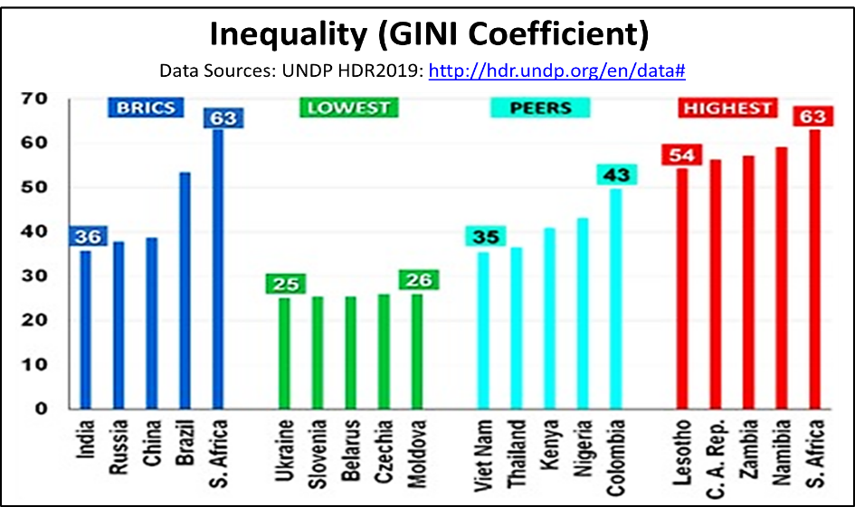
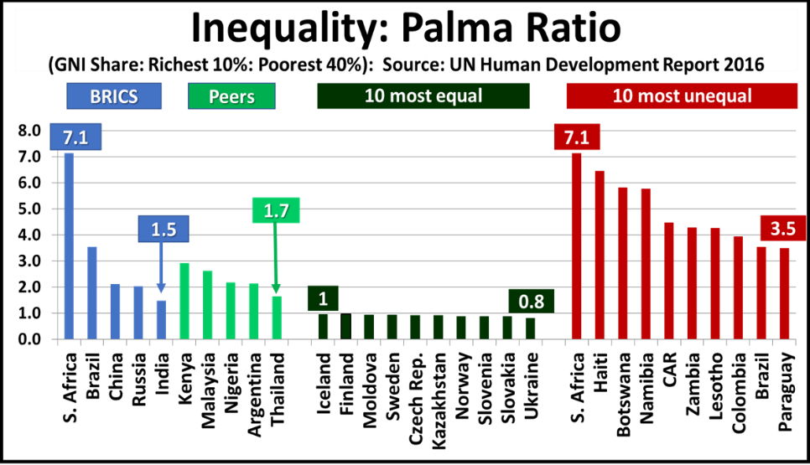
5
South Africa’s Sustainable Development Challenges: Inequality: SDG10
South Africa: Highest level of income inequality in the world;
A dangerously provocative racial bias to this inequality:
GINI Coefficient: Standard statistical measure of inequality: GINI = 100, one person owns all national wealth: GINI = 0, all share national wealth equitably
Palma Ratio: Richest 10% versus Poorest 40%: Ideal ratio is 1:1 | S. Africa world highest

Slide 6
Accelerating digital transformation to reduce and reverse South Africa’s Inequalities
6
What we know:
Poor and unequal education is the biggest contributor to multidimensional inequality
Poverty is both cause and effect of inequality, and is directly influenced by educational poverty and unemployment
The COVID-19 pandemic has been a “wake up” call the world over:
Online learning has become essential in every country, rich and poor: The “information haves” get more, the “have-nots” fall further behind
No country, no nationality, no race, no religion, no ideology, is immune
Broadband access at school is not enough – sometimes counter-productive - many schools were obliged to close in any event
Reliable high quality home access to broadband is the BEST way forward
South Africa strives against extreme inequalities in public education, AND in online connectivity at home - online education for some – not others..
The countries that have contained and reversed extreme inequalities required generations, basic education reform, free ECD and zero educational inequality, and wise application of broadband technology..

Slide 7
South Africa’s Digital Transformation of HOMES: SDG1; SDG4; SDG9; SDG10; SDG17
7
Data Source:
Table 13.1 in
General Household Survey P03182019 for year 2019 - STATS SA
Addresses Target 1.1: “By 2023, 65% of households worldwide with access to the Internet”
Connect 2030 Agenda
https://itu.foleon.com/itu/connect-2030-agenda/growth/
Place where Internet is accessed | Rural/Urban status | Province (%)
 |  | WC | EC | NC | FS | KZN | NW | GP | MP | LP | RSA
At home | Metro | 25.0 | 6.8 | - | 8.3 | 9.9 | - | 15.7 | - | - | 15.4
 | Urban | 16.1 | 3.5 | 5.8 | 4.3 | 6.5 | 3.9 | 9.4 | 6.2 | 5.6 | 7.2
 | Rural | 10.5 | 0.3 | 6.2 | 4.1 | 1.1 | 1.1 | 9.0 | 0.9 | 0.7 | 1.2
 | Total | 21.7 | 3.2 | 5.9 | 5.4 | 5.8 | 2.3 | 14.9 | 3.2 | 1.6 | 9.1
At work | Metro | 28.1 | 24.9 | - | 15.3 | 28.7 | - | 29.1 | - | - | 28.0
 | Urban | 21.9 | 11.6 | 17.8 | 10.8 | 20.6 | 13.8 | 21.5 | 15.6 | 16.9 | 17.1
 | Rural | 9.8 | 5.1 | 10.4 | 7.1 | 4.7 | 4.8 | 5.5 | 5.2 | 5.0 | 5.2
 | Total | 25.4 | 13.4 | 15.7 | 11.7 | 17.7 | 8.8 | 28.8 | 9.7 | 7.2 | 18.6
Using mobile devices | Metro | 72.3 | 65.8 | - | 67.8 | 58.2 | - | 69.4 | - | - | 67.8
 | Urban | 54.2 | 48.6 | 53.8 | 54.4 | 58.0 | 66.2 | 63.3 | 74.8 | 50.5 | 59.5
 | Rural | 34.5 | 39.0 | 42.3 | 47.8 | 41.3 | 50.2 | 29.4 | 60.1 | 37.6 | 44.0
 | Total | 65.2 | 50.3 | 50.5 | 57.7 | 51.7 | 57.2 | 68.4 | 66.4 | 40.0 | 58.7
At Internet Cafes or educational facilities | Metro | 18.9 | 15.8 | - | 13.2 | 11.3 | - | 17.6 | - | - | 16.6
 | Urban | 8.6 | 5.8 | 5.8 | 9.9 | 10.8 | 11.3 | 12.9 | 6.5 | 4.3 | 9.1
 | Rural | 1.1 | 3.1 | 1.8 | 6.9 | 2.2 | 6.2 | 0.0 | 2.7 | 1.7 | 2.9
 | Total | 15.0 | 8.1 | 4.6 | 10.6 | 7.7 | 8.5 | 16.9 | 4.3 | 2.2 | 10.7

Slide 8
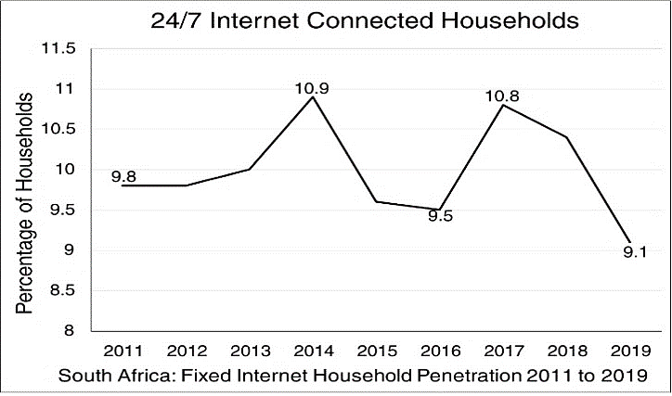
South Africa’s Digital Transformation of HOMES: Benchmark, growth & economy
8
Developing |  | Developed |  | Global Leaders
Country | Value | Country | Value | Country | Value
Argentina | 63 | USA | 88 | France | 100
Vietnam | 55 | Australia | 86 | Switzerland | 100
Colombia | 48 | Ireland | 84 | S. Korea | 100
Thailand | 45 | Uruguay | 82 | Netherlands | 96
S. Africa | 9 | Estonia | 75 | Denmark | 92
Benchmark Countries: GNI per Capita (2019 US$ 000)
Argentina | 11.1 | USA | 65.9 | France | 42.5
Vietnam | 2.6 | Australia | 55.1 | Switzerland | 85.5
Colombia | 6.51 | Ireland | 64 | S. Korea | 33.8
Thailand | 7.26 | Uruguay | 16.2 | Netherlands | 53.1
S. Africa | 6.04 | Estonia | 23.3 | Denmark | 64
Source: World Bank Fixed Broadband Subscriptions per 100: https://data.worldbank.org/indicator/IT.NET.BBND.P2 Fixed Broadband per 100 households: estimates derived from weighting “broadband subscriptions per 100” using average household size. “Value” = estimated % of households with 24/7 broadband.
South African official statistics by STATS SA: General Household Survey series P0318 - 2011 to 2019: (a) Connect 2030 Target 1.1 = 65% by 2023; (b) If affordability of connectivity and terminals impossible, public access recommended

Slide 9
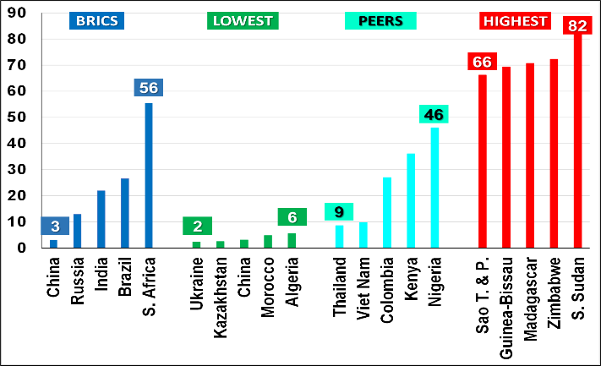
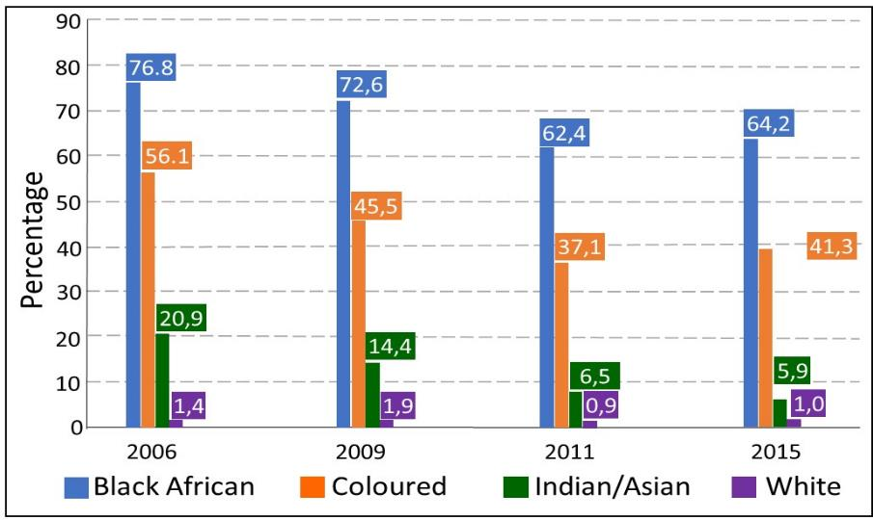
South Africa: Some of the world’s richest, and the poorest, are neighbours in their own land….
9
Chart 1.2b: % Population below National Poverty Line | Chart 1.3a: Poverty measures by Population Group (%)
Data Sources: UNDP HDR2019: http://hdr.undp.org/en/data# http://www.statssa.gov.za/publications/Report-03-10-06/Report-03-10-062015.pdf
Up to 56% South Africans, including children, are a drain, not a gain, on the economy
The “SCARY” part is its racial characteristic – HISTORY tells us this is potentially explosive!
Can both be “Digitally Transformed” to be less volatile or explosive?

Slide 10
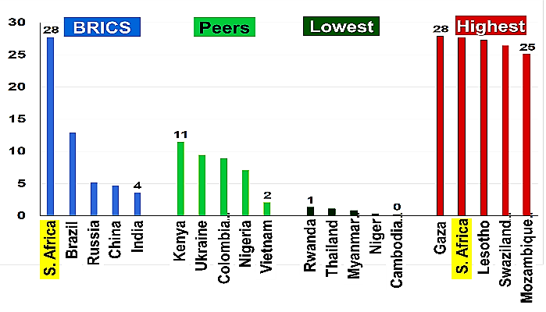
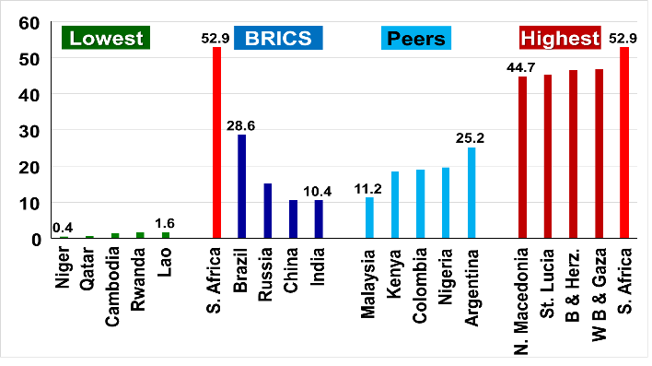
South Africa: Jobs, Jobs, Jobs
“We work to live so that we can live to work”: Dr James Suzman ….
10
Chart 1.4a: National Unemployment:
% of Labour Force 2018
Chart 1.4b: Youth Unemployment:
% of Labour Force
Stats SA July 2019: 29% unemployment
Data download: June 2018
Data update: 27 Sept. 2019
Source: https://data.worldbank.org/indicator/SL.IND.EMPL.ZS
Source: https://data.worldbank.org/indicator/SL.UEM.1524.ZS
The employment outlook is of great concern, especially that of youth unemployment
Exacerbated by Covid-19 – Low skilled most vulnerable to both COVID-19 and 4IR automation
How can “digital transformation” directly help up-skilling, AND containing unemployment?

Slide 11
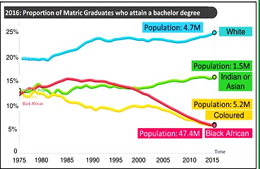
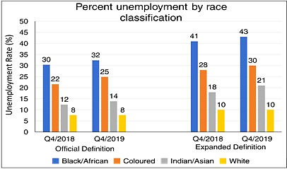
EDUCATION
Deficiencies are the roots of all socioeconomic problems
11
Educational Outcomes by Race: Fodder for Racial Inequalities
Unemployment by Definition and Race: Fuel for National Inequities
https://www.southafricanmi.com/education-statistics.html
http://www.statssa.gov.za/publications/P0211/P02114thQuarter2019.pdf
Education is about the Transfer of Information and Knowledge through Communications
Between Parents and Children, Educators and Learners; Peers, within Communities and Society
ICT is about Communication – Information and Knowledge – Bridging Race & ALL Other Divides

Slide 12
EDUCATION
How does South Africa Compare? – Selected Peers
12
South Africa compared with the highest achievers in the most recent international educational assessments: PISA, PIRLS and TIMSS
Purpose of the comparisons:
What can South Africa learn from these countries:
The link between education and economic development and growth?
Educational performance of the high achievers and South Africa against the international averages?
Focus on the STEM foundation subjects Mathematics, Reading, Science; all vital for the 4IR world
Trigger for further analyses and research:
What sociopolitical historical background of each country, how they got over any parallels with South Africa?
How each high achiever has changed its educational strategies over time
How has each high achiever developed and used/uses ICT to improve their educational outcomes? Their strategies for accelerating digital transformation?

Slide 13
EDUCATION
How does South Africa Compare? – Selected Peers
13
Country | Population | GNP/Capita (US$ PPP) |  | GNP/Capita | Achievements: % above or below average
 | Millions | 1998 | 2018 | 20-yr CAGR (%) | Math | Reading | Science
China² | 1300 | 2410 | 15320 | 9.7% | 8% | 0% | 5%
Estonia³ | 1.3 | 9070 | 35340 | 8% | 6% | 5% | 8%
Finland | 5.5 | 24520 | 49720 | 4% | 4% | 7% | 8%
S. Korea | 52 | 16200 | 39630 | 5% | 7% | 5% | 5%
Sweden | 10.3 | 27250 | 54640 | 4% | 1% | 2% | 0%
Singapore | 5.7 | 40490 | 92150 | 4.5% | 15% | 9% | 13%
Vietnam | 96 | 2120 | 7230 | 7.4% | 1% | -1% | 6%
S. Africa¹ | 58.5 | 7170 | 12530 | 3% | -26% | -36% | -28%
Notes: | (1) Achievement: all PISA 2015 except South Africa which used TIMSS 2015 and PIRLS 2016
 | (2) China Pisa Results for Beijing, Shanghai, Jiangsu and Guangdong Provinces;
 | (3) Estonia; GDP/Capita years 2000 to 2018;
Sources: | (a) Economic data: World Bank Development Indicators; (b) PISA: https://nces.ed.gov/surveys/pisa/pisa2015/index.asp (c) PIRLS 2016 /TIMSS 2015: http://timssandpirls.bc.edu/timss2015/index.html

Slide 14
South Africa Has a Problem!
Not enough “DIGITS” for TRANSFORMATION?
14
The “Cradle of Humankind” - Most likely Ancestral Home of ALL humankind;
Black, Brown, Coloured, Red, White, Yellow, “Rainbow”, Men, Women, Children, Youth, Animist, Buddhist, Christian, Hindu, Jew, Muslim, Pagan, Shinto…
ALL their ancestors may have been “nurtured” in this “Cradle of Humankind”
So, how did the modern-day “Cradle of Humankind” get it so wrong?
Did Mzansi (South Africa) ignore or misunderstand the power of “Digits”? Perhaps a more “demystified, pro-poor & user-friendly” name may be needed?
The Charts and Tables suggest that Mzansi has indeed lost it’s “Digital Direction” – The poor also need Digital Transformation….

Slide 15
WHY?
15
The Price of “Digits” is too high!
Approximately 55% of South Africans cannot AFFORD the digits they need to develop themselves and their country
The 10% Richest South Africans have all the “digits” they need for this competitive Homo economicus age
55% of the nation uses “digits” for basic survival – they need much more for “transformation”- for restoration of their HUMANITY…
The next slide examines this reality

Slide 16
16
Searching for Transformative Digits
The Price of “Digits” in Mzansi
As an “Upper-middle-income” economy, South Africa’s International Poverty Line is US$5.50 PPP per day, or ZAR918 per month (2019 rate)
In 2015, 30.4 million South Africans (55%) lived below the national poverty line (UBPL).
Their total monthly expenditure averaged R768 per month.
At 5% of income or expenditure, their ICT affordability was R38.40 per month.
WTISD 2021 suggests 2% - R15.36 per month
What developmental quality and quantity ICTs can they purchase at this price?
South Africa’s poor majority cannot afford the ICTs they need for self, family, and community development
STATS SA Report-03-10-06 2017

Slide 17
The Price of “Digits” in Mzansi
Still Searching for Transformative Digits
17
South African mobile telephone user price update for WTISD 2021
As the World celebrates the 26th anniversary of WTISD, the price of “transformative digits” needs review:
Recommendations in the (WTISD) Connect 2030 Agenda , 5 Goals and 25 targets are proposed, including:
Target 1.3: By 2023, Internet access should be 25% more affordable (baseline year 2017)
2017 Affordability Report proposes 1GB data price of 2% of average income
Using GNI per capita in lieu of income, this amounts to ZAR 145.9 per month
2% of monthly expenditure for 55% South Africans who are poor amounts to ZAR15.36, ≈10% of recommended price
There are no companies, big, small or micro, who can survive South Africa’s pro-poor price target under prevailing business and competitive models;
2017 Affordability Report proposes use of public access for such “e-Excluded” populations.

Slide 18
The Price of “Digits” in Mzansi
Still Searching for Transformative Digits
18
South African mobile telephone user price update for WTISD 2021
Public demand for lower ICT prices - #DataMustFall – CCSA Data Market Inquiry launched:
April 2021: CCSA pressure obliges leading MNOs to slash data prices:
MTN: 1GB prepaid 30-day bundle from ZAR 149 to ZAR 99, ≈ 6.5 X higher than target
Vodacom: 1GB prepaid 30-day bundle from ZAR 149 to ZAR 85, ≈ 5.5 X higher than target
Recommendation in 2017 Affordability Report – Provide public access for those at the base of the pyramid
The search for effective pro-poor public access for all ages must be intensified
Numerous possibilities exist – Full SDG 17 partnerships essential,
Many past attempts in South Africa – all “top-down”.
A new kind of thinking is needed………..

Slide 19
A quick review of all other SDGs
19
All 17 SDGs are closely Interrelated, Interdependent, & Integrated
Failure in one leads to failure of others – a domino effect
Example: Lose your job (SDG8) you become poor (SDG1); hungry (SDG2); Sick from Hunger and exposure (SDG3); unable to educate your kids (SDG4); defenseless against gender abuse; etc., all the way to SDG17 – unable to participate in the coordinated efforts trying to help you.
Because of extreme multidimensional inequality, South Africa is vulnerable to all the SDG challenges – details beyond the scope of this presentation
A few examples will be presented
As in the MDGs that preceded the SDGs, ICTs, digital or otherwise, are recognized as key components (enablers) of all development
ICTs by any other name deliver:
Information & Knowledge of what causes SDG challenges, how to deal with them, where to find help, how to ameliorate and prevent their recurrence
All modern ICTs are now built on digital technologies, hence this WTISD theme DIGITAL TRANSFORMATION IN (TODAY’S) CHALLENGING TIMES

Slide 20
20
EXAMPLE 1
Water/Sanitation: SDG6 | Poverty: SDG1 | Health: SDG3 | Clean Energy: SDG7 | Infrastructure: SDG9 | Inequality: SDG10 | Consumption: SDG12 | Climate: SDG13 | Partnerships: SDG17
Eight SDGs that are inseparable:
South Africa is a water-scarce country: ranked world 30th driest country, nearly half mean global annual precipitation (450mm versus 850mm), climate change vulnerability – SDG6, 13;
Poverty and Inequality exacerbate water consumption – poverty in rural areas drives urban migration, urban water demand rises (SDG1+10+12); urban consumption & SDG6 infrastructure deficiency challenges;
Excellent knowledge of modern sanitation, extremely poor unequal application, nation-wide sanitation failures, health challenges, e.g., Vaal System Sewage Disaster (2021 SAHRC);
Inadequate water capacity for hydroelectric generation – low investments and incentives for renewable energy development, poor management of existing energy infrastructure (e.g., Eskom); complex transborder regional energy cooperation, vulnerable to climate change;
Inadequate informed partnerships between citizens, government, civil society, and industry; disruptive institutional silos: URGENT NEED FOR FOCUSSED ICT4SDG.
This complex compendium of interdependent SDGs demands excellence in the key components of SDG17 – communications, Collaboration, Coordination, Cooperation, all supported by excellent ICT utilization well beyond connectivity – transformational digital usage.

Slide 21
21
EXAMPLE 2
Cities and communities: SDG11 | Poverty: SDG1 | Health: SDG3 | Inequality: SDG10 | Consumption: SDG12
Cape Town; Durban; Johannesburg have tried…
Disappointing or Unexpected Outcomes the general rule
Similar experiences in Brazil, Canada, India
Too many national leaders and city planners dream big, prestigious SMART CITY projects
Too often self-serving focus on city administrative and management challenges
Too often, the poor people living in “Informal Settlements” or “Squatter Camps” are forgotten….

Slide 22
22
EXAMPLE 3
PUBLIC ACCESS ATTEMPTS IN SOUTH AFRICA
General:
Most attempts at bridging the nation’s ICT affordability divides, ranging from Telecentres to USALS and USAASA activities have been disappointing or outright failures
ICT Industry
All Significant Market Powered (SMP) ICT companies have tried public ICT access, little or no success:
Vodacom 2008 (with Qualcomm): (b) 2012: Internet Solutions, Cyber Influx: (c) November 2013:
MTN launches eStreet mobile internet cafés: (d) May 2015: Telkom launches R100 million FutureMakers programme
Educational Establishments:
Limited possibility, bureaucratic, security and child-safety reasons prevent innovative ideas: ICT literacy must/will become standard tuition in education curricula, but mass impact will require generations….. We must act now!
Internet Cafés:
Numerous attempts, sustainability in middle/higher income areas (typical ZAR60 per hour), very high failure rate in poor areas. Numerous historical examples from most developing and developed counties, market forces driving changed business models – integration of mobile and fixed public access – big screens for better learning.
There are few options for South Africa’s economically marginalized population and children
Each public access model must be reviewed, re-examined, re-imagined, re-attempted
Failure must not be an option – the costs are too high

Slide 23
Where to next?
23
South Africa will not solve the nation’s ICT4SDG challenges using traditional public ICT access models
Creative new solutions are needed, without reinventing the wheel, and failing yet again. Past mistakes are critical inputs for new knowledge
Traditional ICT developments are heavily focused on technology – e.g. “Accelerating “digital” transformation – who wants to transform “digits”? - a clearly stated re-focus on people & users, using modern technology, may be helpful
ICT infrastructure development will be two-fold:
Traditional market-driven “top-down” models for mid/wealthy users
Massive refocus on multistakeholder supported pro-poor SMME-owned/operated models with focus on mothers & young children
The next slide examines this reality

Slide 24
24
Recommendations for this WTISD 2021
SOUTH AFRICA: to reinforce national commitment to the SDGs in furtherance of the NDP 2030 objectives, and to strengthen national attention on ICT4SDG in the overall SDG process – through the DCDT and all related public and private institutional partners and non-institutional stakeholders
SOUTH AFRICAN MULTISTAKEHOLDERS: (a) all must recognize the essentiality of broad national support for pro-poor development overall, and pro-poor ICTs in particular. (b) actively participate in expanding and encouraging action by all multistakeholders, especially local authorities like SALGA
THE ICT INDUSTRY: help to build the public access facilities, reaping benefits in the long run from informed market expansion; foster market growth for new 4IR products and services
The ITU and WTSID: (a) Finalize the revisions of the IDI process and widely publish final results; (b) reinforce ongoing ITU and general international development agencies efforts aimed at strengthening national statistical agencies, and the use of the most people-focused indicators for SDG success; (c) reconsider the importance of open data for transparent refinement and dissemination of key ICT indicators worldwide – IDI Database = CHF 281 = Free 4 All to see and act where they can….
Reconsider the ICT Development Model proposed in WTISD 2020

Slide 25
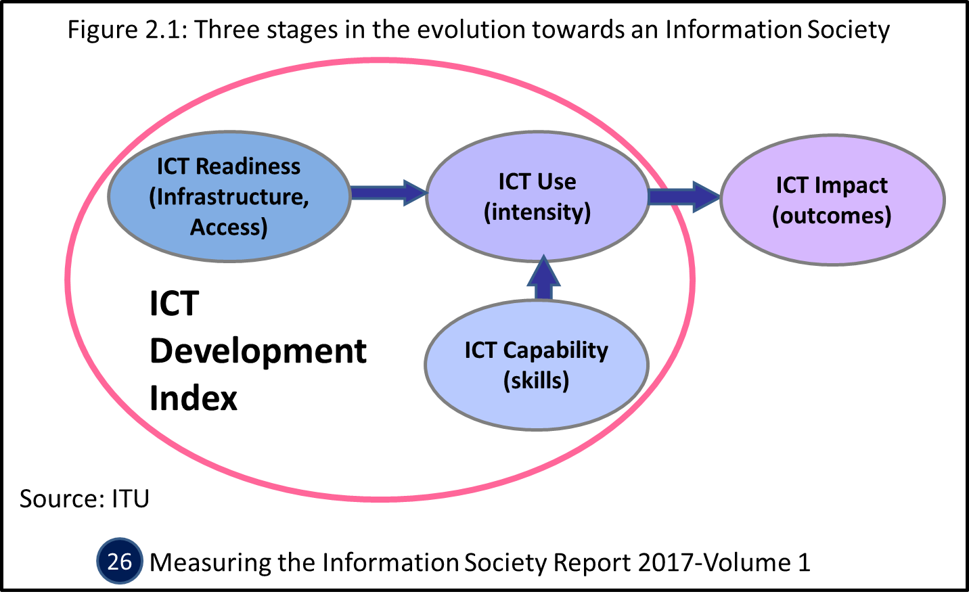
25
From WTISD 2020
Suggested Conceptual Change – From..
ICT Development index (IDI)
Introduced through WSIS process in 2008
First MIS Report 2009
Designed by ITU to:
Measure progress in ICT Dev.
Enhance ICT developmental role
Data to reduce the Digital Divide
Criticism:
Techno-centric – lacks a HUMAN FACE………
Loses relevance for poor where deep inequality exists
Indicators updated from 2018

Slide 26
Key changes
Retain free-market development model with current changes in global economic thinking (e.g. COVID-19 effect/response)
Reinforce strong focus on the poor – public access to advanced services serves as complimentary national strategy
Build basic public access places that overcome the current barriers to mass scale application
Encourage action-oriented R&D in all SDG-related disciplines, as part of daily activities. Focus on the very young and poor first..
From WTISD 2020
Suggested Conceptual Change – To..
26
Develop PEOPLE through ICTs FIRST – then ICTs through People!
2
How used, how much, where
ICT Impact
(outcomes)
ICT4SDG
ICT Use
(intensity) ICT4 Each SDG
Now, LET’S JUST DO IT!
ICT Readiness
(Infrastructure, Access)
SDG9
For whom? For what? From where? To where?
1
ICT Capability
(skills)
ICT4SDG4
ICT for Sustainable
Development
Identify desired impact and outcomes FIRST
How ALL can/must use it
Design ICT Infrastructure for Impact and Outcomes
Source: W.B.
Building ICT Networks for Sustainable Development for ALL

Slide 27
27
Thank You
walter@sakan.org.za

